Slide 1
Handwritten Digit Recognition Using Convolutional Neural Networks (CNN)
By Gopalakrishnan Kumar, MTech IIT-Bombay,
Math AI Trainer, Outlier AI , Freelance Data Science Consultant
LinkedIn: Profile Link : https://www.linkedin.com/in/gopalakrishnankumar-a73301110/
Github:https://www.github.com/Gopalakrishnan-Kumar/
Kaggle URL- https://www.kaggle.com/gopalkk2

Slide 2
Google Colab URL
https://colab.research.google.com/drive/1S0dcwR_a7uomBf-QF42uLeF6Zpje-vRb?usp=sharing

Slide 3
Introduction
The classification of handwritten digits is a classic problem in the field of pattern recognition. It serves as a foundational project for computer vision and deep learning, helping demonstrate the capabilities of neural networks in image classification.
This project aims to develop a machine learning model using Convolutional Neural Networks (CNNs) that can automatically recognize and classify digits from 0 to 9 based on grayscale images of handwritten digits from the MNIST dataset.

Slide 4
Dataset Overview
Dataset: MNIST (Modified National Institute of Standards and Technology)
Source: Yann LeCun’s MNIST Database
Total Images: 70,000 grayscale digit images
60,000 training samples
10,000 testing samples
Image Size: 28x28 pixels
Classes: 10 (digits 0 through 9)
Each image contains a single centered digit in white (foreground) on a black background.

Slide 5
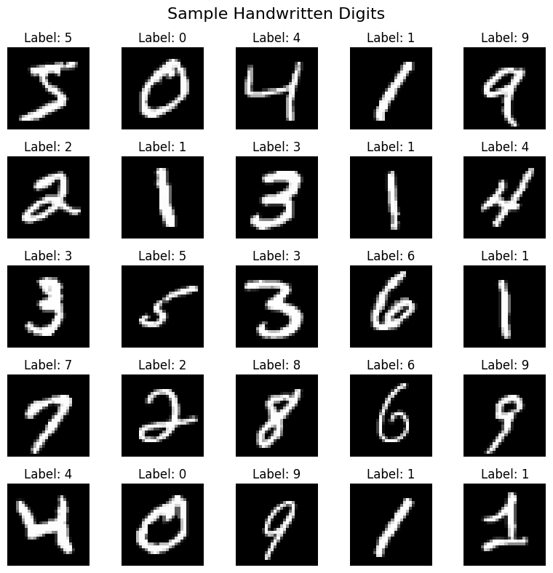
Data Visualization

Slide 6
Data Preprocessing
Before training, the dataset was preprocessed to improve model performance:
Normalization: Pixel values were scaled to the range [0, 1] by dividing by 255.
Reshaping: Input images were reshaped to (28, 28, 1) for CNN compatibility.
Label Encoding: One-hot encoding was applied to the class labels.
Train-Test Split: Predefined by MNIST — 60k for training, 10k for testing.

Slide 7
Model Architecture
A Convolutional Neural Network was chosen due to its high efficiency in image recognition. The architecture includes:
Layer Type | Parameters
Conv2D | 32 filters, 3x3 kernel, ReLU
MaxPooling2D | 2x2 pool size
Conv2D | 64 filters, 3x3 kernel, ReLU
MaxPooling2D | 2x2 pool size
Flatten | -
Dense | 128 neurons, ReLU
Dropout | 0.5 (prevents overfitting)
Output (Dense) | 10 neurons, Softmax (for classification)

Slide 8
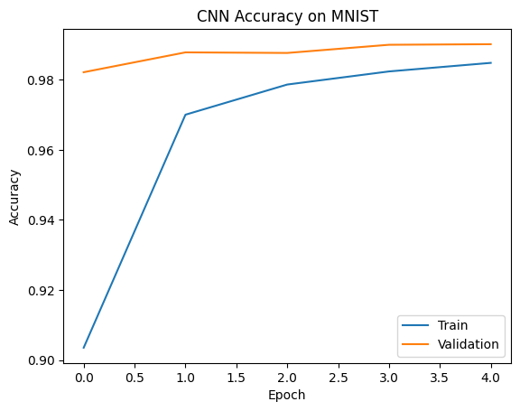
Data Visualization

Slide 9
Training Configuration
Loss Function: Categorical Crossentropy
Optimizer: Adam
Batch Size: 128
Epochs: 5
Validation Split: 10% of training data used for validation

Slide 10
Performance Evaluation
After training, the model was evaluated on the test set. Key metrics:
Metric | Value
Accuracy | ~99.1%
Loss | Low (≈0.03)
Precision | >98%
Recall | >98%

Slide 11
Insights
Digit “1” and “0” had the highest accuracy due to their distinct shapes.
Digits “3” and “5” or “4” and “9” were occasionally misclassified due to visual similarity.
The dropout layer helped reduce overfitting by deactivating 50% of neurons
during training.

Slide 12
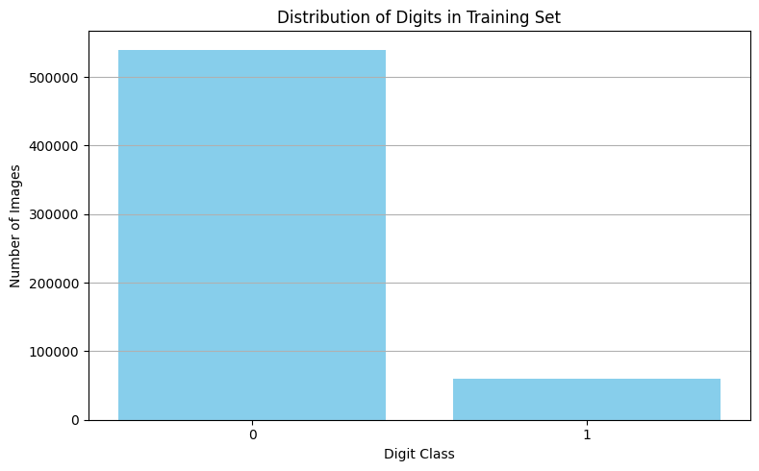
Data Visualization

Slide 13
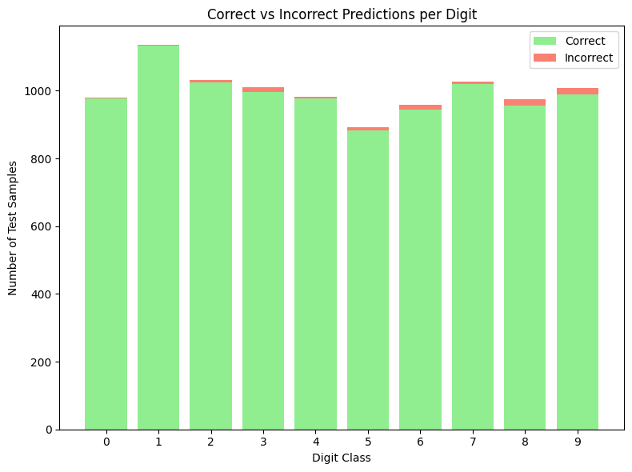
Data Visualization

Slide 14
Conclusion
This project successfully demonstrates the use of CNNs in solving handwritten digit classification with impressive accuracy. Using a well-structured architecture and MNIST’s balanced dataset, the model achieved over 99% test accuracy and made highly reliable predictions across all digit classes.

Slide 15
Applications
Bank check digitization
Postal code recognition
OCR (Optical Character Recognition)
Mobile apps for form filling or digit entry

Slide 16
Future Enhancements
🔁 Data Augmentation: Apply rotations, shifts, and zoom to improve generalization.
🧠 Transfer Learning: Use pre-trained models like ResNet or MobileNet for more complex datasets.
📱 Deployment: Build a web app using Streamlit or Flask for real-time digit recognition.
📦 Export Model: Save the trained model as .h5 or .tflite for mobile/embedded deployment.

